Slide 1
Role-based Campus Network Slicing
Presenter：Hung-Yen Wang
Authors：Chien-Hsin Chen,Chien Chen,Ssu-Hsuan Lu,Chien-Chao Tseng
Published in：2016 International Conference on Network Protocols
Department of Computer Science and Information Engineering
National Cheng Kung University, Taiwan R.O.C.
Notes:
1
ICNP = International Conference on Network Protocols

Slide 2
Introduction
Today’s campus networks are facing major challenges such as mobile clients, huge video bandwidth demand, and the growing number of connected devices and applications. Therefore, a campus network management system needs to support diverse sets of users, devices, applications, and ways of connecting efficiently.
Different tenants are required to have different access privileges. Thus the campus network needs to isolate traffic among multiple tenants and operate logical networks over a single physical network.

Slide 3
Introduction

Slide 4
Introduction
FlowVisor is a work done on network virtualization by using OpenFlow.
FlowVisor can slice a physical network into several virtual networks which are called slices. The slice is composed of all packets matching the specific headers, and each slice has its own controller which simplifies the management of how to send the packets. The information about the slices’ controllers and the matching rules is stored in the flowspace table of FlowVisor.

Slide 5
Introduction
The campus network provides wireless access so that different roles of users may send traffic through any wireless Access Point, thus slices cannot be decided just by slicing the topology. Therefore, FlowVisor needs to do MAC-based slicing by recording the mapping between the MAC addresses of devices and the types of users. Because the users may carry different devices at different times, this mapping should be dynamical. Therefore, an authentication controller is applied to our framework to help FlowVisor classify packets into different slices. The authentication controller authenticates users and classifies their devices into different slices.

Slide 6
Introduction
However, with a growing number of devices in the campus network, the size of the flowspace table in FlowVisor will increase enormously.
To solve this heavy loading problem in FlowVisor, a VLAN-based slicing is developed by appending VLAN tags to packets to represent the roles of users.

Slide 7
Proposed Framework

Slide 8
Proposed Framework
An authentication controller is applied to authenticate users and classify their devices into corresponding slices. When a user’s devices join the campus network, the authentication controller authenticates the user and decides which slice the devices belong to. Then it adds the user’s devices to the flowspace of the associated slice.

Slide 9
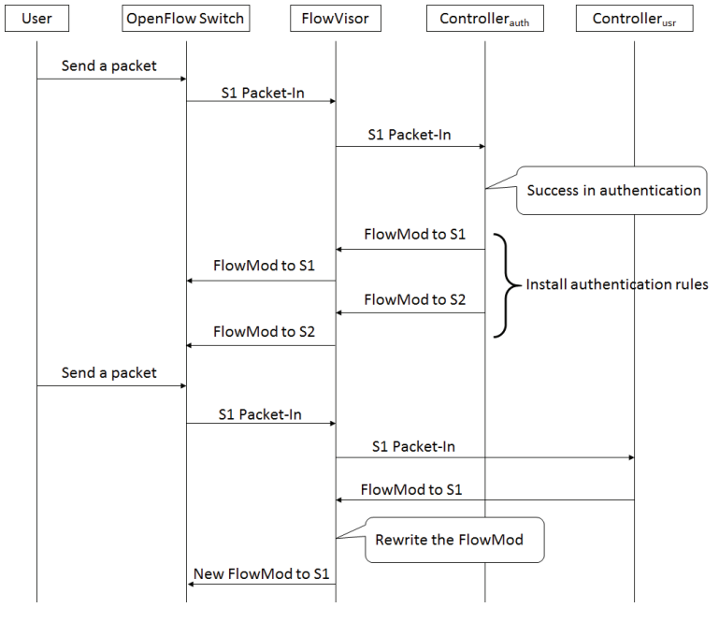
Message Sequence Diagram

Slide 10
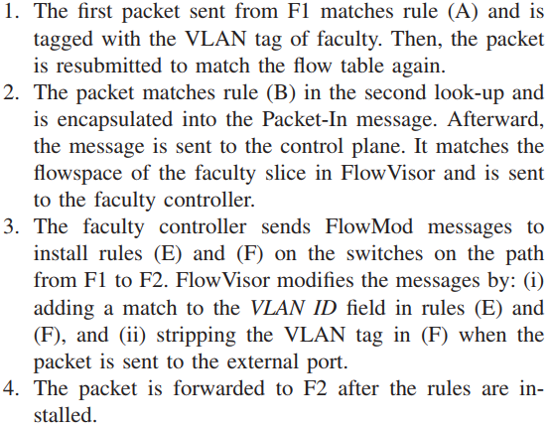
Intra Slice Communication

Slide 11
Internet Access

Slide 12
MAC-based Slicing
One simple way to implement role-based campus network slicing is mapping a group of devices’ MAC addresses to form a slice. For each device, the authentication controller will insert a MAC and slice ID mapping into the flowspace table in FlowVisor.
Therefore, to establish a new SDN flow, the first Packet-In message after the device has been authenticated should try to match the device’s MAC address in the flowspace table of FlowVisor to decide which user controller the device should be sent to.
Notes:
12

Slide 13
VLAN-based Slicing
The authentication controller maintains the mapping between MAC addresses of devices and types of users, the authentication controller installs rules into OpenFlow switches to add the VLAN tags associated to packets.
Instead of inserting flowspace entries in the flowspace table of FlowVisor like MAC-based slicing, the authentication controller installs the authentication rules into switches during the authentication process.
In this way, the flowspace of each slice is simplified to just one entry. The number of flowspace entries can be reduced to the number of roles of users.
Notes:
13

Slide 14
VLAN-based Slicing
FlowVisor maintains the settings of the slices. If FlowVisor receives packets that do not have VLAN tags, it sends the packets to the authentication controller. Otherwise, FlowVisor sends the packets to the controller according to their VLAN tags. The authentication controller installs rules to switches to add the VLAN tags to the packets when the packets enter the campus network and remove the VLAN tags when the packets leave the campus network to their destinations.
Notes:
14

Slide 15
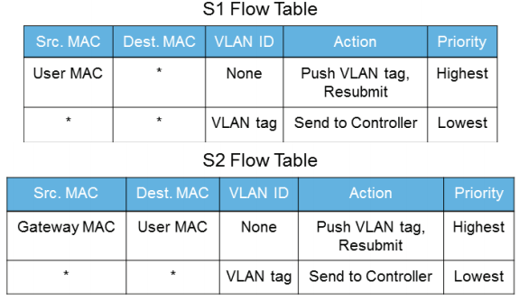
VLAN-based Slicing
When a user is authenticated, the authentication controller installs rules on two switches. One is the switch (S1) that the user is connected to. The other one is the switch that connects to the gateway (S2). The reason for installing rules on S2 is to provide access from Internet to users.
Notes:
15

Slide 16
VLAN-based Slicing
Because hosts cannot recognize packets with VLAN tags, FlowVisor needs to strip VLAN tags when packets go to external ports. Therefore, the routine where FlowVisor handles FlowMod messages received from the control plane is modified.
If the action of the FlowMod message is unicast, FlowVisor checks whether the output port is an external port by using network topology which is maintained inside FlowVisor. If the output port is an external port, a new action is added to the FlowMod message for stripping the VLAN tag.
Notes:
16

Slide 17
Simulation Environments
Mininet was used to generate network topologies and hosts for the experiments. FlowVisor, Mininet, and two instances of controllers were run on the same virtual machine which was installed on a computer with one i5 CPU 2.6 GHz processor and 8G memory.
Floodlight was used as the controller.
Notes:
17

Slide 18
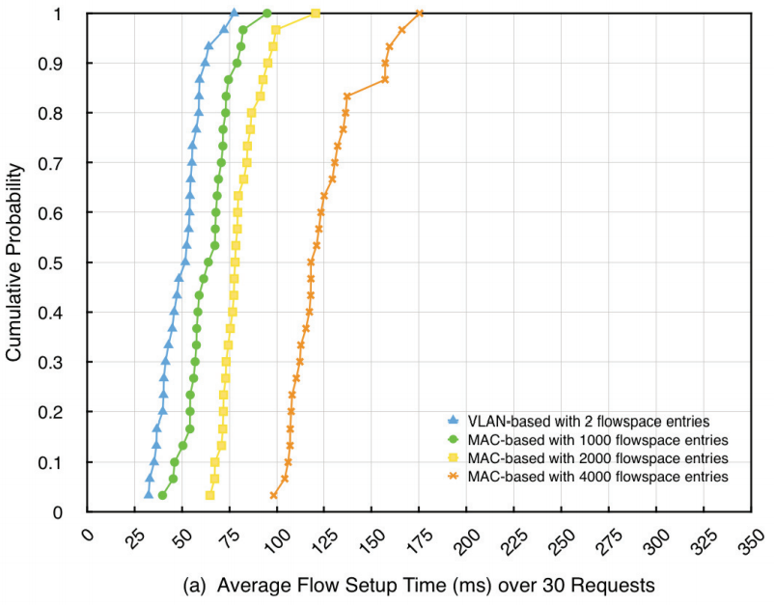
Latency
Notes:
18

Slide 19
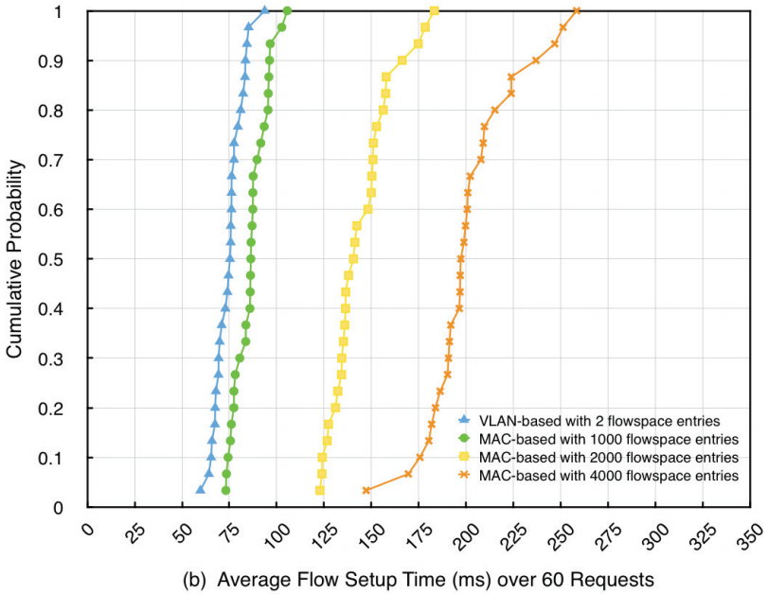
Latency
Notes:
19

Slide 20
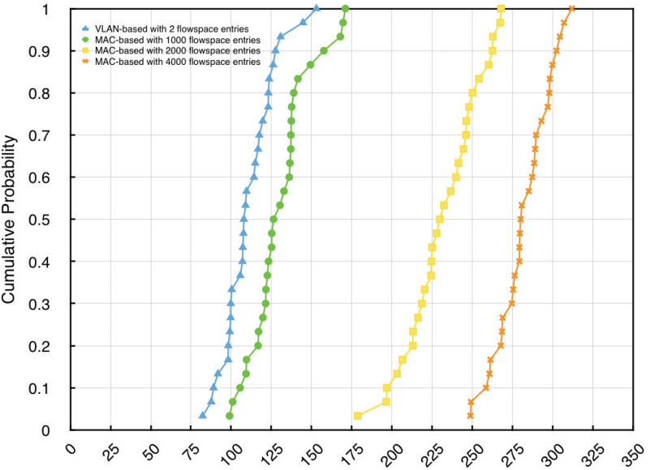
Latency
Notes:
20

